Slide 1

Internet of Things
(IoT)
Transforming the Future

Slide 2

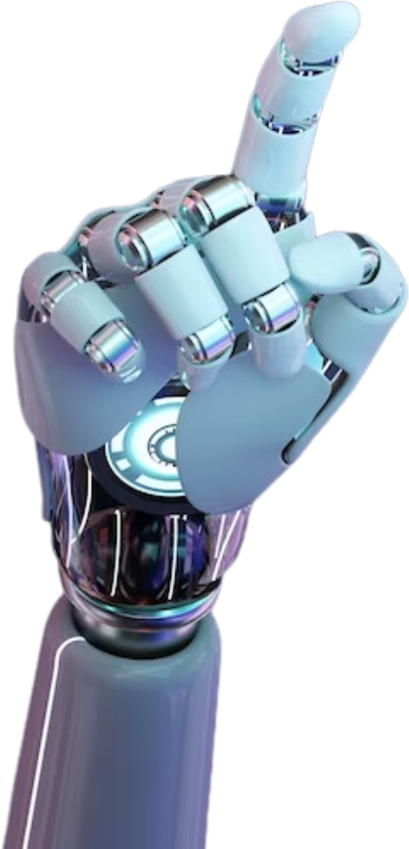
What is Internet of Things(Iot)
02
concept of the connected physical devices or appliances through the
Internet. In other words, the network of connected devices such as
home appliances, office equipment, industrial machines, motor
vehicles, and many such types of things that can be controlled through
built-in embedded software applications through the
intercommunication with mobile applications or other centralized
platforms.

Slide 3
02
Importance of Internet of Things(IoT)
IoT encompasses more than just physical device connections to the internet; it also plays a role in human daily activities. such as:
  Efficiency
  Reduces Costs
  Enhances Quality of Life
  Improves Safety and Security
  Automation

Slide 4
02
Importance of Iot
The concept of IoT is so important because it sits at the core of numerous automation schemes such as home, automation, office automation, industrial automation, and many other automated processes in all domains of businesses. When all machines and devices can communicate and take action and instructions, the whole world will become very much connected and efficient.

Slide 5
02
Architecture of IoT Ecosystem
Researchers and industry experts have not settled on a single standard architecture for the IoT ecosystem. Instead, several primary models are recognized based on the complexity and scope of the deployment

Slide 6
02
Architecture of IoT Ecosystem
1. Three-Layer Architecture
The foundational and simplest model, often used for basic IoT applications:
Perception (Sensing) Layer: Physical sensors and actuators that collect real-world data (e.g., temperature, motion) and interact with the environment.
Network Layer: Transmits gathered data from the perception layer to processing units via wireless or wired technologies (e.g., Wi-Fi, 5G, Cellular, Bluetooth).
Application Layer: Delivers user-facing services and interface capabilities based on processed data (e.g., smart home dashboards, asset tracking systems).

Slide 7
02
Architecture of IoT Ecosystem
2. Four-Layer Architecture
Adds an explicit processing layer to manage data volume before reaching applications:
Perception Layer: Data gathering via sensors and hardware.
Network Layer: Secure data transmission.
Support / Middleware (Processing) Layer: Executes data storage, filtering, analytics, and decision-making (e.g., cloud platforms, database systems).
Application Layer: Industry-specific solutions like smart grids, autonomous logistics, or smart healthcare.

Slide 8
02
Architecture of IoT Ecosystem
3. Five-Layer Architecture
Designed for enterprise-scale or complex industrial IoT (IIoT) setups:
Perception (Objects) Layer: Gathers environmental and machine data.
Transport Layer: Transfers data across networks to the processing stage.
Processing (Middleware) Layer: Analyzes, filters, and stores massive datasets.
Business Layer: Manages the overall IoT system logic, business models, user privacy, and strategic workflows.
Application Layer: Final user applications tailored to specific operational needs.

Slide 9
02
What Is Decentralized Internet of Things Concept?
What Is Decentralized Internet of Things Concept?
Decentralized IoT—also known as Smart IoT—is an advanced architectural framework driven by cutting-edge technologies like Multi-access Edge Computing (MEC), Blockchain (Distributed Ledger Technology), Artificial Intelligence (AI), and Machine Learning (ML). By shifting away from traditional centralized cloud models, it provides businesses with a highly reliable, cost-effective, secure, and performant ecosystem.
Key Components
Multi-Access Edge Computing (MEC): Shifts compute power, data processing, and software-defined resources closer to the network edge, significantly boosting scalability, speed, and efficiency.
Blockchain Technology: Establishes strong trust, data integrity, and security across the network by eliminating single points of failure without relying on a central authority.
AI & Machine Learning: Enables edge devices to process localized data autonomously and make intelligent, real-time decisions.

Slide 10
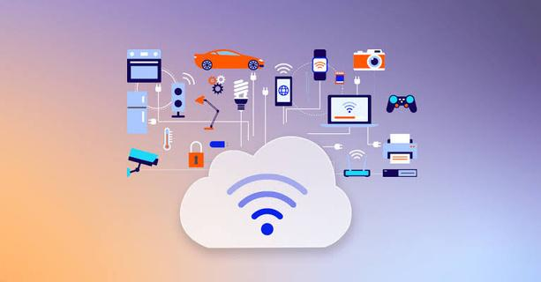
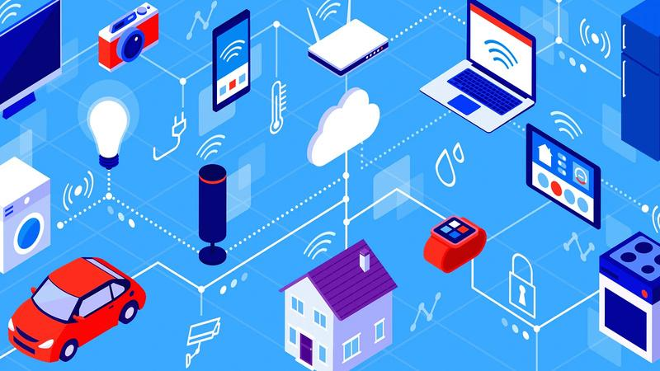
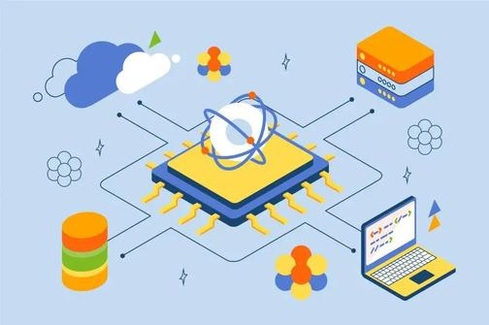
Evolution of IoT
03
The Internet of Things (IoT) evolved from early experimental novelties—such as Carnegie Mellon’s web-connected soda machine in 1982—into a massive global infrastructure that officially surpassed the human population in connected devices by 2009. Coined by Kevin Ashton in 1999 around RFID supply chain tracking, the concept accelerated through the 2010s as smartphone proliferation, cheap sensors, and cloud computing fueled a boom in consumer smart home ecosystems and Industrial IoT (IIoT) factory automation.

Slide 11
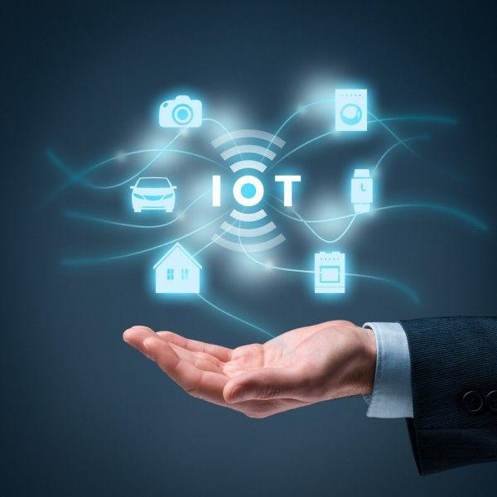
Early Milestones of "IoT"
05
  1982 (The First "Thing"): Computer scientists at Carnegie Mellon University connect a Coca-Cola vending machine to check drink availability and temperature remotely.
  1990–1991: John Romkey creates the first internet toaster; Cambridge researchers deploy the Trojan Room coffee pot camera.
  1999 (The Official Name): Kevin Ashton officially coins the phrase "Internet of Things" during a supply chain presentation at Procter & Gamble regarding RFID tracking.

Slide 12
Types of IoT
04
CONSUMER IOT (CIOT)
INDUSTRIAL IOT(IIOT)
COMMERCIAL IOT
Used across manufacturing, energy, and logistics, it connects factory automation, heavy machinery, and supply chains to monitor asset health, predict equipment failures, and optimize production.
focuses on commonplace home or personal applications. Examples include wearable technology (fitness trackers, smartwatches), home security systems, and smart home appliances (smart thermostats, connected lights).
Utilized in enterprise, retail, and public spaces to improve operational efficiency and customer experience. Examples include smart building automation (HVAC and lighting systems), automated checkout systems, digital signage, and asset tracking in warehouses.

Slide 13
Types of IoT
04
INFRASTRUCTURE AND SMART CITIES (PUBLIC IOT)
INTERNET OF MEDICAL THINGS (IOMT) / HEALTHCARE IOT
AGRICULTURAL IOT (AGRI-IOT)
Deployed across municipal environments to manage public resources and infrastructure. Examples include smart grids for energy management, adaptive traffic control systems, smart waste management sensors, and structural health monitoring for bridges and roads.
Used for medical and health monitoring purposes. Examples include remote patient monitoring devices, smart pills, connected pacemakers, and real-time hospital asset tracking systems.
  Deployed in farming environments to automate and optimize agricultural practices. Examples include soil moisture sensors, weather tracking stations, automated irrigation systems, and livestock tracking tags.

Slide 14
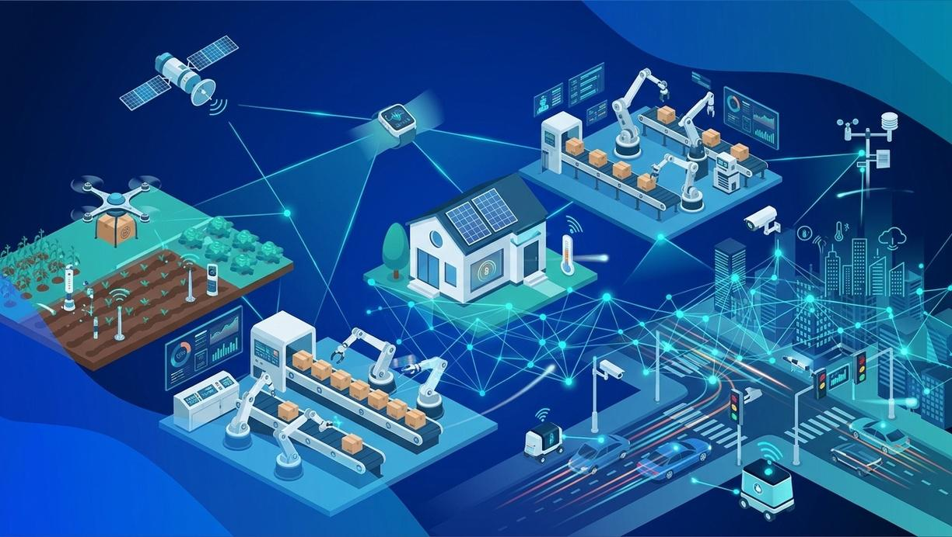
Internet of Things platform
An IoT platform manages device connectivity. It can be a software suite or a cloud service. The purpose of an IoT platform is to manage and monitor hardware, software, processing abilities, and application layers.
Sensor technologies
IoT or "smart" sensors convert physical variables into digital data. For example, temperature sensors detect heat variations, while motion sensors monitor ultrasonic waves to trigger actions when movement disrupts the signal.

Slide 15
Main features of the Internet of Things (IoT):
Effective Endpoint Management: Centralized control and monitoring of all connected devices across the network.
High Scalability, Analytics, and System Integration: Capability to expand seamlessly while processing large datasets and connecting with existing infrastructure.
Robust Automation and Physical Asset Security: Automated workflows and protection systems for machinery and equipment.
Increased Device Efficiency and Energy Savings: Optimized operational performance that minimizes power consumption.
Efficient Connectivity: Seamless communication between devices and human operators.
Deployment of Greater Sensing Capabilities: Advanced sensor arrays that capture precise, real-world data.
Active Engagement with Everyday Devices: Integration of modern connectivity into everyday personal and industrial tools.
Incorporation of Cutting-Edge Technologies: Integration with artificial intelligence (AI) and machine learning (ML) for predictive and autonomous operations.

Slide 16
History of Internet of Things:
Industrial process automation began in 1950 with the introduction of SCADA systems for sensing and data transmission. Modern IoT automation originated in 1980 when Carnegie Mellon programmers networked a Coke machine to remotely track bottle availability, temperature, and queue times.
1950: The predecessor of automation through the Internet of Things traces back to the introduction of Supervisory Control and Data Acquisition (SCADA) systems, which automated industrial processes using complex sensing and transmitting systems.
1980: The modern concept of IoT-based automation was marked when programmers at Carnegie Mellon University modified a coke dispenser using computer code to check the temperature, availability, and waiting queue of coke bottles in the dispenser.
1999: The term "Internet of Things" was coined by Kevin Ashton, and Radio Frequency Identification (RFID) technology was introduced.
2000: The first smart refrigerator was introduced by LG Corporation.
2008: The number of connected devices crossed the number of people on the Earth.
2009: Google Inc. started testing driverless cars.
2011: Google's Nest smart thermostat was introduced in the market.
Present: The IoT world has expanded tremendously and is expected to make a significant impact on all walks of life very soon with the adoption of 5G technology.

Slide 17
What is Ambient Intelligence in IoT?
The concept of ambient intelligence, precisely referred to as AmI, is the development of such devices or elements that use pervasive computing, sensing power, adaptivity, and intelligence by collected data from the environment and processing through computing power. The concept of ambient intelligence was coined by Eli Zelkha and colleagues in 1990
The main examples of ambient intelligence that have used the high level of sensing devices and artificial intelligence in their invention
include Neura app, Otter.ai, ElliQ and others. These services helped a
range of categories of people to make their lives so easy

Slide 18
Autonomous Control in IoT
Autonomous control introduces a higher level of intelligence to the Internet of Things through Knowledge-Enhanced Electronic Logic (KEEL). Known as the Internet of Autonomous Things (IoAT), this concept moves beyond standard condition-based logic. Instead, IoAT devices use advanced sensors, actuators, and artificial intelligence to gather data from multiple environmental sources, allowing them to evaluate conditions and make independent decisions much like a human would.

Slide 19
Range of Enabling Technologies Behind Internet of Things
Internet of Things has evolved through numerous concepts that use a
range of modern technologies, especially information technology,
electromechanical technologies, sensing device electronics, and others.
The most common technologies that enabled the concept of IoT to grow
exponentially include the following:
Low Power Sensors
Cloud Computing
Artificial Intelligence
Machine Learning
Data Analytics
Big Data
Enhanced Connectivity
Internet Protocol V6.

Slide 20
Low-Power Sensors-
Low-power sensors enhance the efficiency and lifespan of IoT devices across home, building, and industrial automation. By minimizing energy consumption, they enable continuous operation. Key examples include low-power Bluetooth modules, ambient light sensors, smart hubs, digital geomagnetic sensors, digital microphones, programmable push buttons, integrated environmental sensors, and smart heat sensors.
Cloud Computing
Cloud computing provides a scalable, cost-effective, and fully managed infrastructure for centralizing IoT systems. By shifting processing away from individual edge devices, it allows organizations to manage vast networks, analyze large volumes of real-time sensor data, and ensure seamless system interoperability.

Slide 21
Artificial Intelligence (AI) AI powers dynamic and interactive IoT environments by analyzing complex patterns. Software applications leveraging AI enable advanced capabilities like biometric recognition, automated decision-making, and real-time environmental adaptations.
Machine Learning (ML) Machine learning allows IoT systems to improve through data input and continuous training. By recognizing operational patterns and understanding surrounding conditions, ML drives critical applications in autonomous vehicles, aviation, and predictive operations.

Slide 22
Data Analytics Exponential growth in connected devices leads to a massive surge in generated data, requiring immense analytical capacity. Advanced data analytics powered by artificial intelligence enables systems to quickly process and extract actionable insights from these vast datasets.
Big Data Managing the enormous volume of information generated by IoT networks is a complex challenge. Big data technologies provide the necessary infrastructure to efficiently store, organize, and process these high-velocity data streams across connected environments.

Slide 23
Effective Communication Protocols Communication protocols serve as the backbone of IoT, enabling seamless data exchange across short-, medium-, and long-range wireless networks. They facilitate reliable sensing, control, and interaction between connected devices and management systems.
Internet Protocol Version 6 (IPv6) With the number of connected devices vastly outnumbering the global population, legacy IPv4 addresses are insufficient. IPv6 provides an nearly unlimited pool of unique IP addresses, ensuring long-term scalability and seamless global connectivity for expanding IoT networks.

Slide 24
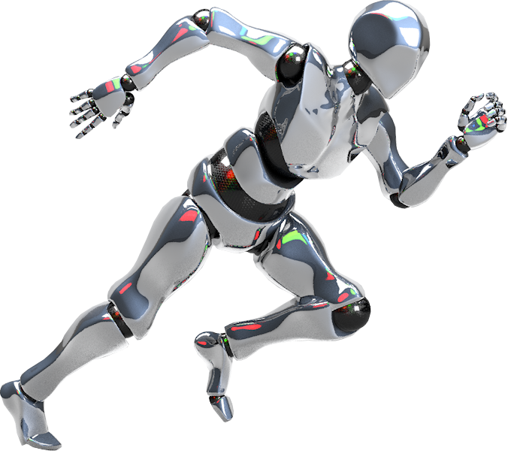
Challenges of IoT
07
Challenges Posed by Internet of Things
As the IoT landscape expands at an unprecedented rate adding millions of new devices in a matter of days the lack of universal regulations and standardized control protocols introduces significant obstacles across multiple domains:
Cybersecurity: Expanding network endpoints creates vast attack surfaces, making devices and systems vulnerable to unauthorized access, malware, and large-scale botnet attacks.
Privacy: Continuous data collection from consumer and industrial devices raises critical concerns regarding unauthorized surveillance, data exposure, and user consent.
Complex Operations and Management: Deploying, updating, and maintaining heterogeneous networks with millions of interconnected devices strains operational resources and infrastructure.
Environmental Impact: Rapid hardware turnover leads to mounting electronic waste (e-waste) and high cumulative power consumption from always-on devices and processing centers.
Bulky Data: Massive volumes of high-velocity data generated by edge devices overload storage systems, consume network bandwidth, and strain analytical pipelines.

Slide 25
Thank
You!

